Slide 1

Logistic Regression Intro
By
Amritansh
M.S. in CS (Concentration in AI)
AI Researcher (Core AI, Deep Learning, Swarm Robotics)
Mentor of Change @ Atal Innovation Mission (AIM) by Niti Aayog

Slide 2
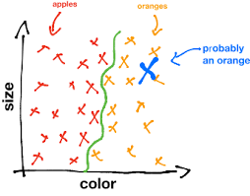
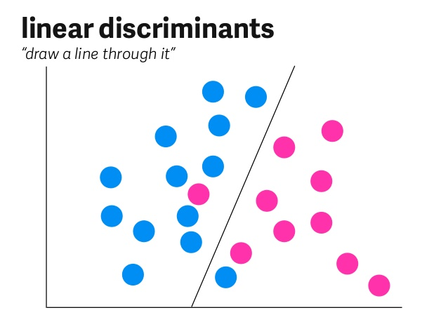
Classification
Classification is the problem of identifying to which of a set of categories (sub-populations) a new observation belongs, on the basis of a training set of data containing observations (or instances) whose category membership is known

Slide 3
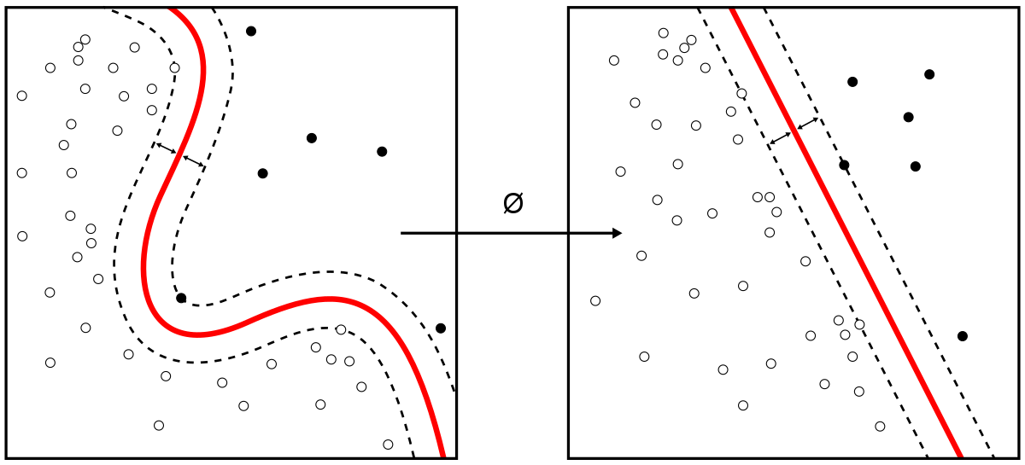
Classification
Y is discrete (0,1) or (A, B)
Email : Spam or Not Spam
Cancer : Benign or Malignant
Food Types: Vegan, Vegetarian, Non – Vegetarian

Slide 4
Why can’t we use Linear Regression ?
Regression line

Slide 5
Logistic Regression
Logistic Regression was developed by statistician David Cox in 1958
The binary logistic model is used to estimate the probability of a binary response based on one or more predictor (or independent) variables (features). It allows one to say that the presence of a risk factor increases the odds of a given outcome by a specific factor.
Logistic Regression was used in the biological sciences in early twentieth century.

Slide 6
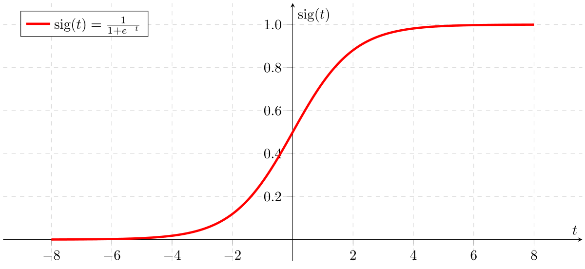
Sigmoid Function
A sigmoid function is a bounded, differentiable, real function that is defined for all real input values and has a non-negative derivative at each point.
Sigmoid is synonymous to Logistic function

Slide 7
Interpretation
Sigmoid function outputs a probability of P(1)
Thus if we get P = 0.75, it means there is 75% probability of happenstance of 1
If we get P = 0.3, then there is 30% probability of happenstance of class 1, and simultaneously 70% probability of Happenstance of Zero(0)
Probability needs to be 1 when all partial probabilities are added : P(1) + P(0) = 1
Thus, P(0) = 1- P(1)

Slide 8
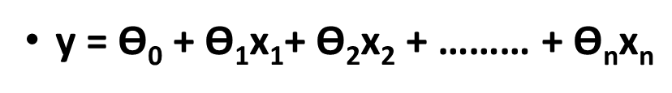







Hypothesis
If you remember hypothesis in linear regression:

Slide 9
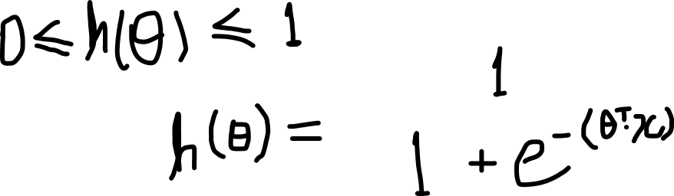
Hypothesis (Logistic)

Slide 10
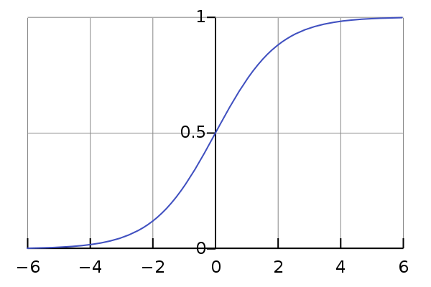




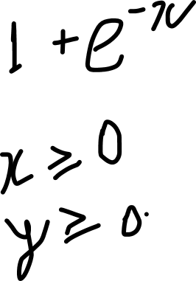
As we see in sigmoid if the input is positive then we get value more than 0.5
Thus, we need input hypothesis to be greater than Zero (0)

Slide 11

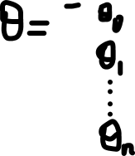

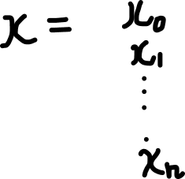

Slide 12
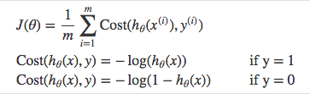



Cost function
Instead of Mean Squared Error, we use a cost function called Cross-Entropy, also known as Log Loss. Cross-entropy loss can be divided into two separate cost functions: one for y=1 and one for y=0.

Slide 13





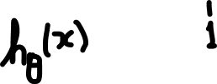
The benefits of taking the logarithm reveal themselves when you look at the cost function graphs for y=1 and y=0. These smooth monotonic functions (always increasing or always decreasing) make it easy to calculate the gradient and minimize cost.

Slide 14




Vectorized form of Cost function

Slide 15








Decision Boundary
In case of Binary Classification
To predict which class a data belongs, a threshold can be set.
if predicted_value ≥ 0.5, then classify email as spam else as not spam.

Slide 16






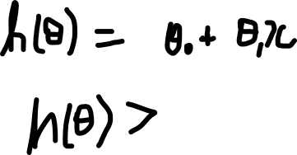

We want sigmoid(x) > 0.5, thus we need hypothesis to be positive

Slide 17












Slide 18
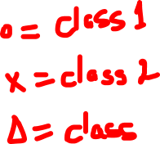
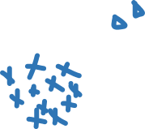


Logistic regression for Multiclassifcation

Slide 19






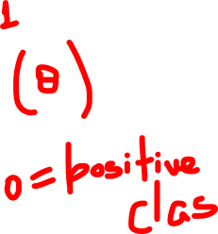

One vs All

Slide 20
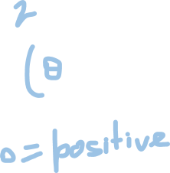



One vs All

Slide 21

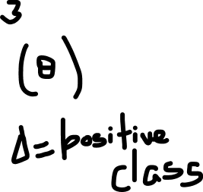
One vs All

Slide 22



Run individual logistic regression on all 3 hypothesis considering 1 class group as positive class
Calculate probabilities for 3 such hypothesis
Final output =

Slide 23
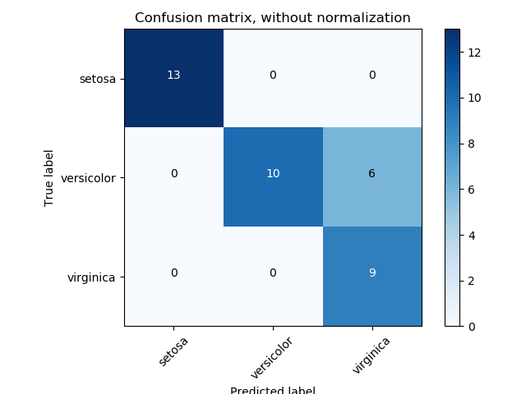
Confusion Matrix
A confusion matrix is a table that is often used to describe the performance of a classification model (or "classifier") on a set of test data for which the true values are known.

Slide 24
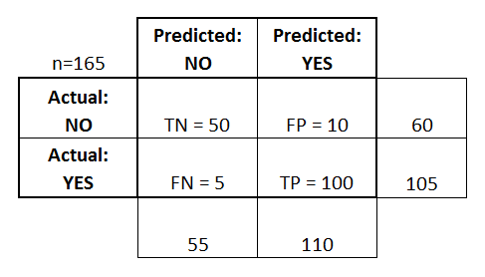
Terminologies
Accuracy: Overall, how often is the classifier correct?
(TP+TN)/total = (100+50)/165 = 0.91
Error Rate: Overall, how often is it wrong?
(FP+FN)/total = (10+5)/165 = 0.09
Also equivalent to (1 – Accuracy)
Precision: When it predicts yes, how often is it correct?
TP/(FP + TP) = 100/(100 +10) = 0.91
Recall: How many true positives were found?
TP /(TP + FN) = 100 / (100 +5) = 0.95
TN = True Negatives
TP = True Positives
FN = False Negatives
FP = False Positives

Slide 25
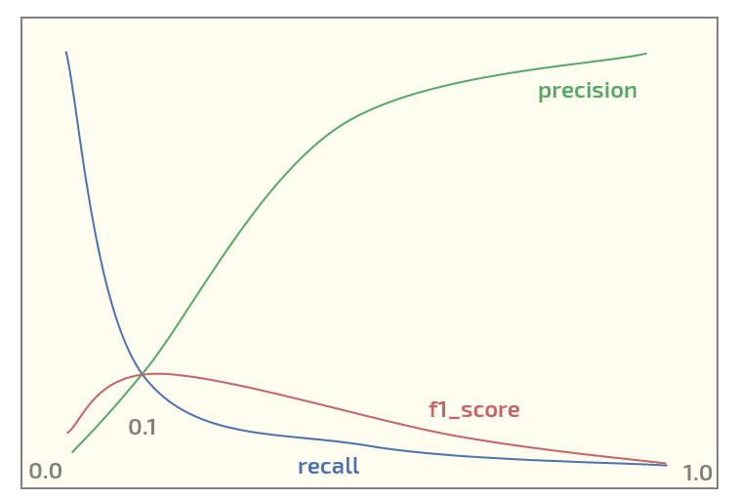
F1 Score
F1 score is the harmonic mean of Precision and Recall values of a trained classifier model
Mathematically,
F1 = 2 *( Precision x Recall)/(Precision + Recall)
The F1 score( or F-Score) conveys the balance between the precision and the recall

Slide 26
Advantages
The output of a logistic regression is more informative than other classification algorithms. Like any regression approach, it expresses the relationship between an outcome variable (label) and each of its predictors (features).
Easy to design and run across various datasets
Correlations are explainable thus providing transparency in creating decision boundaries

Slide 27
Use Cases
Image Classification
Spam filtering
Medical Diagnosis
Drug trial analysis
Customer segmentation
Fraud detection
Object segmentation
Digit recognizer
OCR

Slide 28
Thank You!!!

